Slide 1
A study on the path of reform and development of shrinking cities in the context of population mobility - The Case of Detroit in America
Team 14

Slide 2
National distribution of shrinking cities in the US
Population Change in Detroit
Major Industry Changes in Detroit - Urban Transformation
Future Urban Development Path in Detroit - Urban Simulation
Past
Now
Future

Slide 3
Visualisation of shrinking cities across the US
What is the shrinking city/city shrinkage?
Why USA?
Filtering - Cities with a population greater than 10,000 and two consecutive years of downward population movement
National map- by State/City

Slide 4
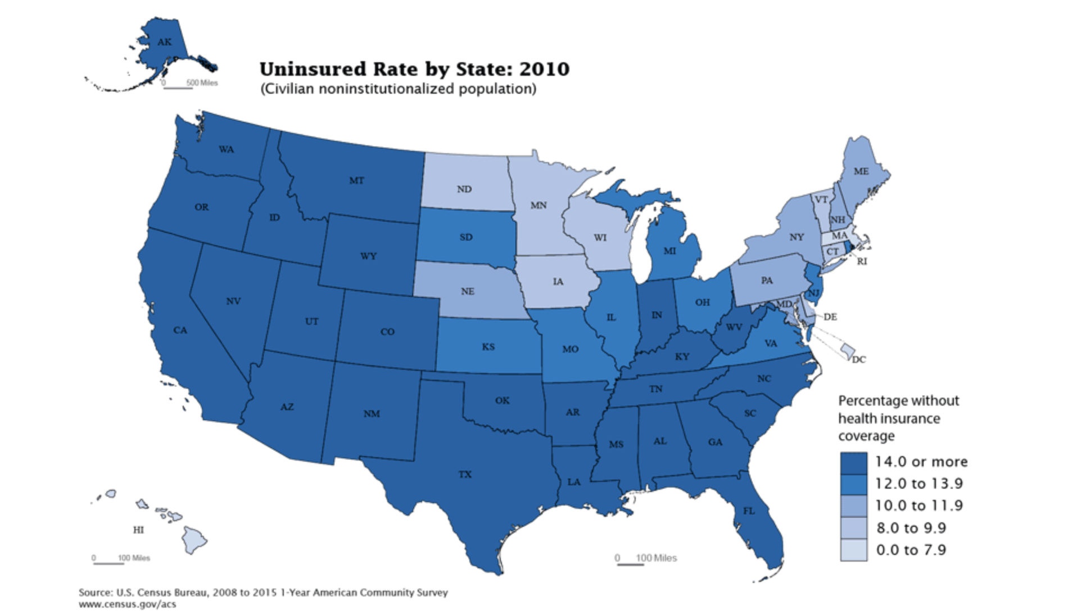

Slide 5
2. The change of population distribution in Detroit
Why Detroit?
Year Span
Resident population? Household income? Census
Unemployment rate?

Slide 6
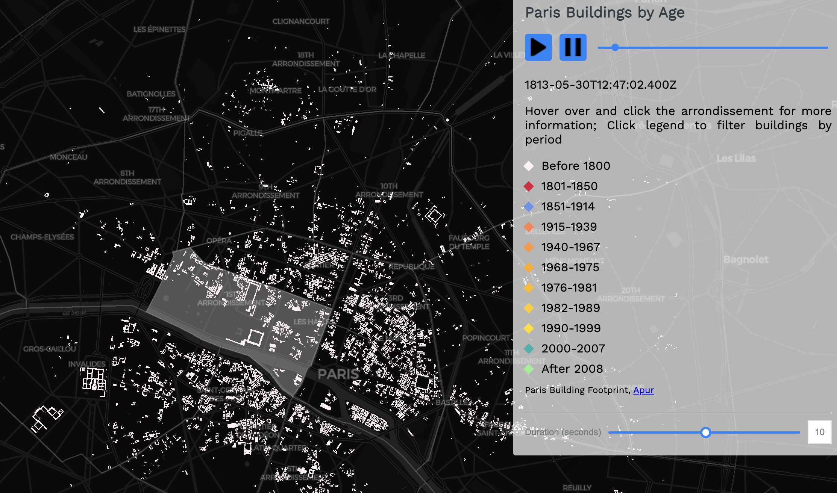

Slide 7
3. Major Industry Changes in Detroit - Urban Transformation
Industry Classification：
mainly about secondary and third industry
Colour distinction, year slider
Number of companies? Industry share? (Statistical Yearbook)
Trendency of GDP

Slide 8
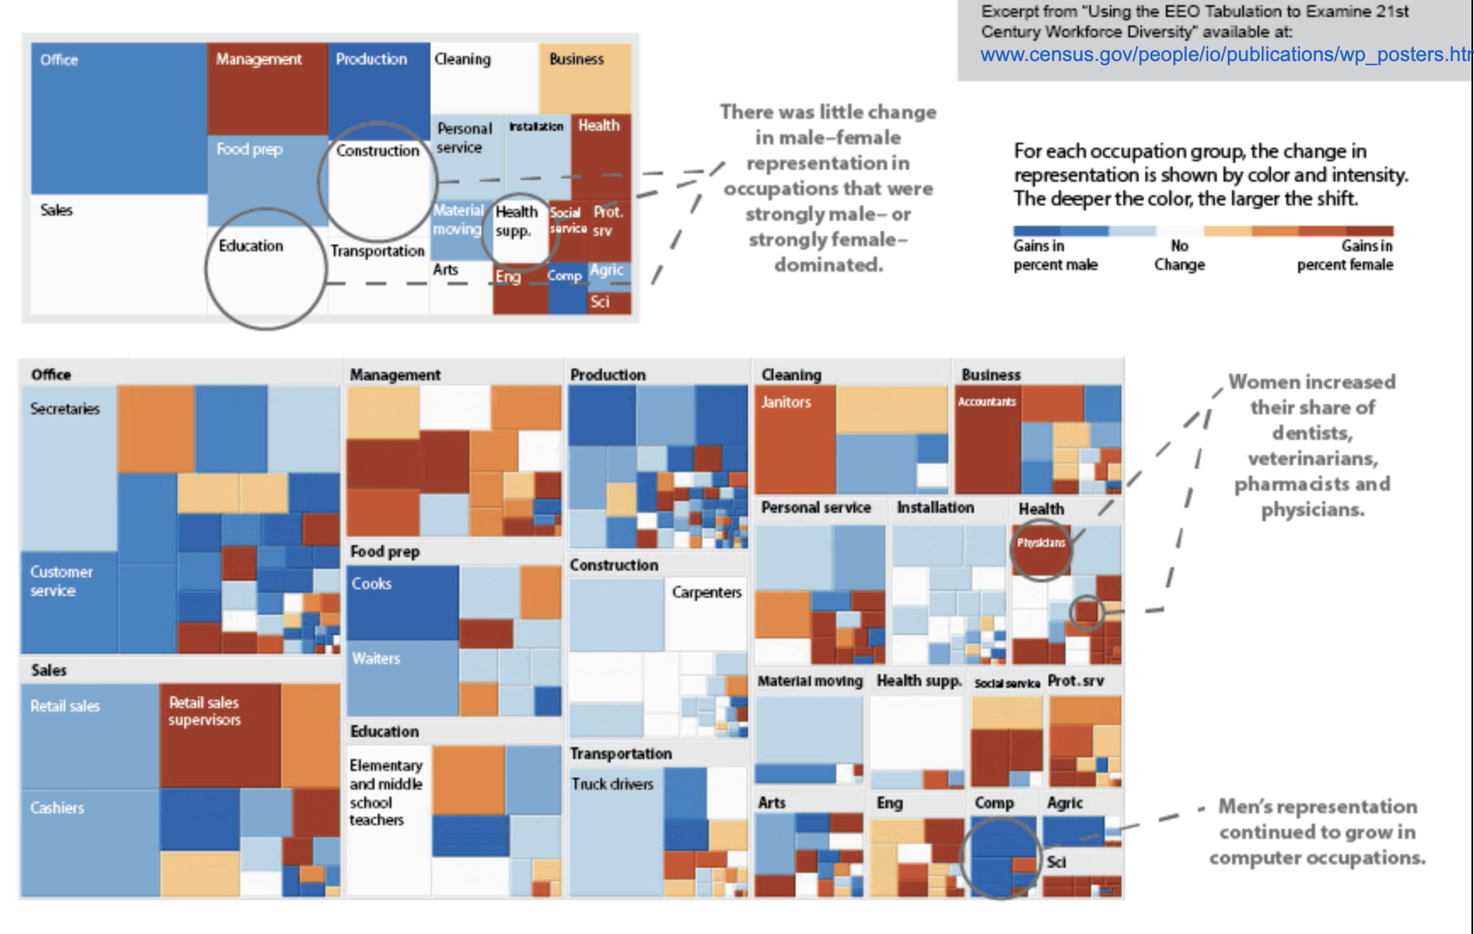
Industry Classification：
Colour distinction
and
Year slider

Slide 9
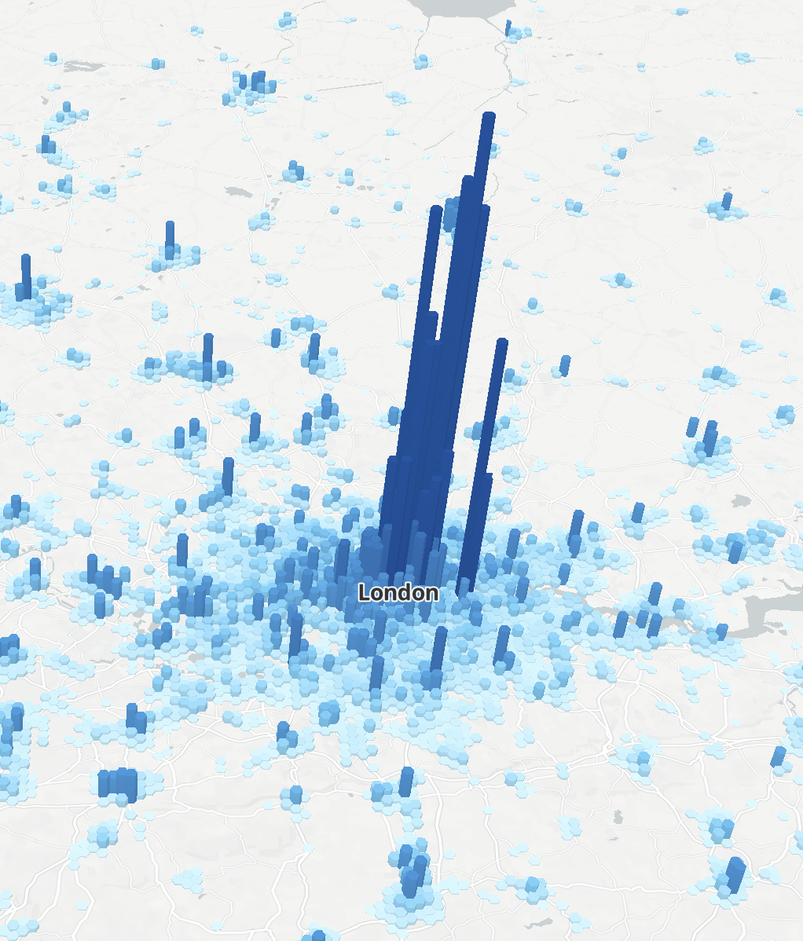
Industry share
Distribution of company
Trendency of GDP

Slide 10
4. Detroit's Future Development Path - Urban Simulation
Policy-oriented interpretation of planning options—DETROIT FUTURE CITY:Detroit Strategic Framework Plan
Projects, policies, possible industrial transfers
Similar to a tourist attraction, marked on a map and accompanied by an explanation of the policy

Slide 11
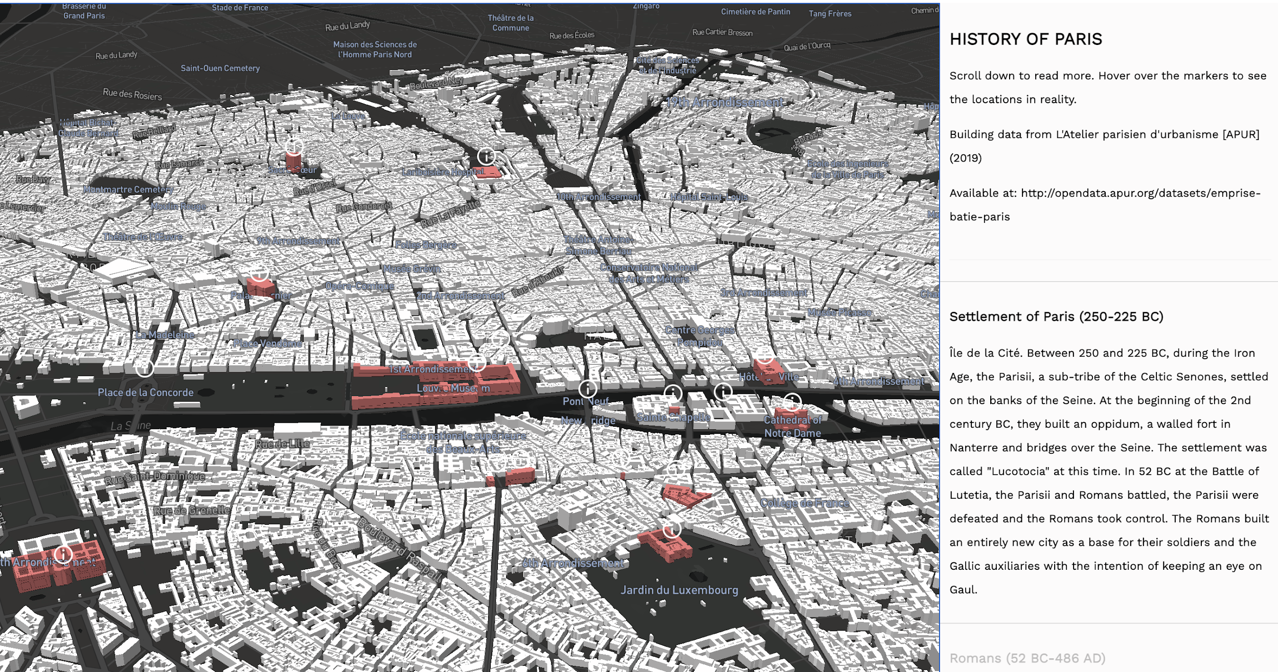

Slide 12
Others
Uniformity of style: colour palette, city scale, date
Tools：mapbox、d3、dc.js、tableau
Server Construction：Python + Flask
Web：similar to squarespace
Accrual Basis：One chart per person, Take charge of individual slides, data sharing
Duration of display：4-4.5mins/p

